Slide 1
Unit 4- Continue

Slide 2
Word Senses and relations
Word Senses refer to the different meanings a word can have in various contexts.
Each distinct meaning of a word is called a "sense."
The study of word senses is critical in natural language processing (NLP) for understanding and generating human language accurately.
Relationships Between Senses are the semantic connections that exist between different senses of words.
WordNet, a lexical database of English, extensively documents these relationships.

Slide 3
Types of Word Senses
Synonymy:
Words with the same or nearly the same meaning.
Example: {car, automobile}
Antonymy:
Words with opposite meanings.
Example: {hot, cold}
Hyponymy:
A specific word whose meaning is included in a more general word.
Example: {dog} (hyponym of {animal})
Hypernymy:
A general word that includes the meanings of more specific words.
Example: {animal} (hypernym of {dog})

Slide 4
Meronymy:
A word that denotes a part of a larger whole.
Example: {wheel} (meronym of {car})
Holonymy:
A word that denotes a whole of which a part is mentioned.
Example: {car} (holonym of {wheel})
Troponymy:
A verb that denotes a specific manner of performing another verb.
Example: {to jog} (troponym of {to run})
Entailment:
A verb that implies the action of another verb.
Example: {to snore} (entails {to sleep})
Coordinate Terms:
Words that share a common hypernym and are at the same level of specificity.
Example: {car, bus, bicycle} (coordinate terms under {vehicle})

Slide 5
Word Sense Disambiguation (WSD)
Word Sense Disambiguation (WSD) is the process of determining which sense of a word is used in a given context. This is essential for accurate language understanding in applications such as machine translation, information retrieval, and more.
Approaches to WSD:
Supervised Methods:
Use labeled data to train machine learning models to predict the correct word sense based on context.
Techniques: Support Vector Machines (SVM), Neural Networks.
Unsupervised Methods:
Cluster contexts of word usage to identify different senses without labeled data.
Techniques: Clustering algorithms, distributional similarity.
Knowledge-Based Methods:
Leverage lexical resources like WordNet to determine the correct sense.
Techniques: Lesk algorithm, similarity measures based on definitions.
Contextualized Embeddings:
Use deep learning models (e.g., BERT) to generate context-aware word embeddings that capture different senses.
Example: BERT can distinguish between "bank" in "river bank" and "financial bank" based on context.

Slide 6
Disambiguation Process:
Identify the context words surrounding the target word.
Compare the context with the definitions (glosses) of each sense in WordNet.
Choose the sense with the highest overlap or most relevant meaning based on the context.

Slide 7
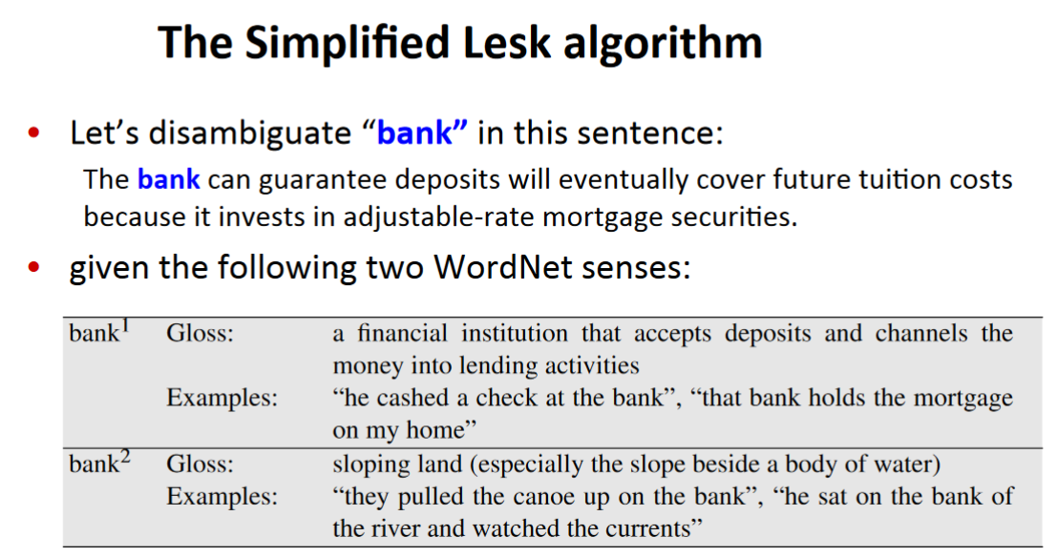

Slide 8
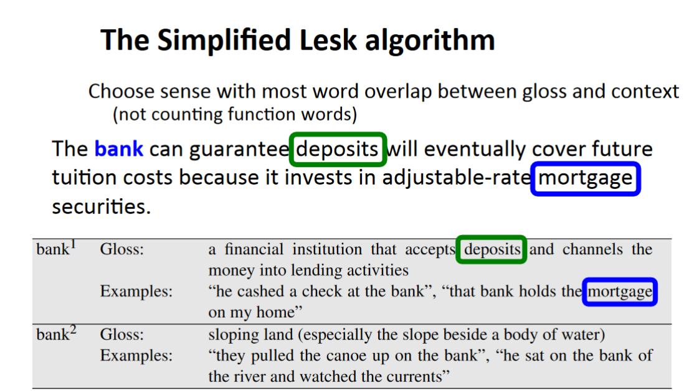

Slide 9
Drawback
Glosses and examples migh be too short and may not provide enough chance to overlap with the context of the word to be disambiguated.

Slide 10
The Corpus(-­‐based) Lesk algorithm
Assumes we have some sense-­‐labeled data (like SemCor)
Take all the sentences with the relevant word sense:
These short, "streamlined" meetings usually are sponsored by local banks¹, Chambers of Commerce, trade associations, or other civic organizations.
Now add these to the gloss + examples for each sense, call it the “signature” of a sense. Basically, it is an expansion of the dictionary entry.
Choose sense with most word overlap between context and signature (ie. the context words provided by the resources).

Slide 11
Corpus Lesk: IDF weighting
Instead of just removing function words
Weigh each word by its `promiscuity’ across documents
Down-­‐weights words that occur in every `document’ (gloss, example, etc)
These are generally function words, but is a more fine-­‐grained measure
Weigh each overlapping word by inverse document frequency (IDF).
20

Slide 12
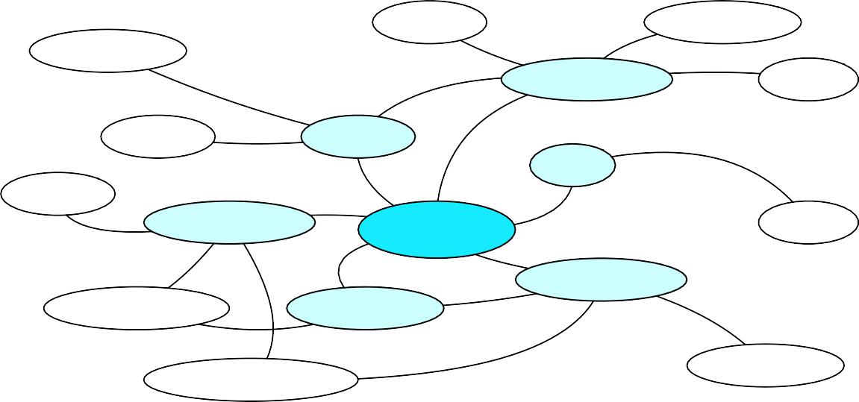
Graph based methods
First, WordNet can be viewed as a graph
senses are nodes
relations (hypernymy, meronymy) are edges
Also add edge between word and unambiguous gloss words
food_{n}¹ liquid_{n}¹
helping_{n}¹
beverage_{n}¹ milk ¹
n
An undirected graph is set of nodes tha are connected together by bidirectional edges (lines).
toast_{n}⁴
drink_{n}¹
sip ¹
sup ¹
v
v
consume ¹
1
sip ¹
v
drink_{v}
n
drinking_{n}¹
consumer_{n}¹ drinker_{n}¹
21
potation_{n}¹
1
consumption_{n}

Slide 13
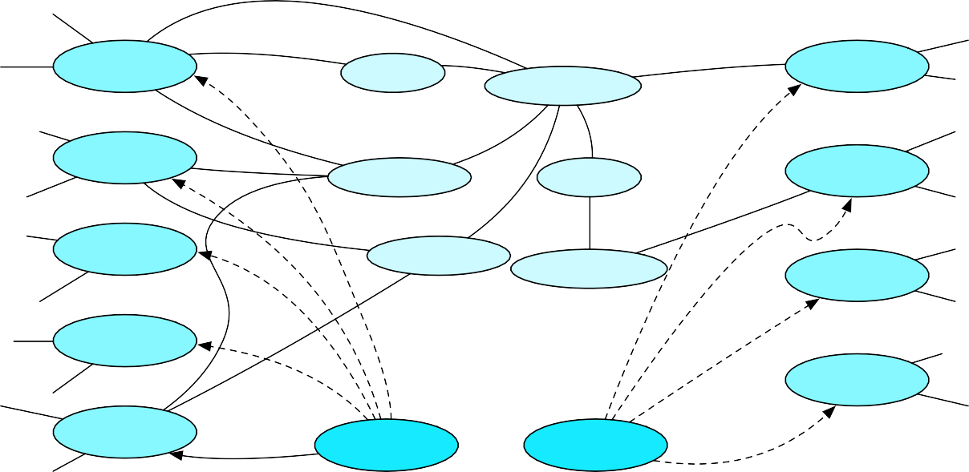
How to use the graph for WSD
“She drank some milk”
choose the
most central sense
drink ¹
drink ¹
milk ¹
v
n
beverage_{n}¹
n
(several algorithms have been proposed recently)
2
drink_{v}
drinker_{n}¹
food_{n}¹
2
milk_{n}
drink ³
boozing ¹
v
n
nutriment_{n}¹
milk ³
n
drink ⁴
v
4
milk_{n}
22
5
drink_{v}
“drink”
“milk”

Slide 14
Word Meaning and Similarity
Word Similarity: Thesaurus Methods

Slide 15
Word Similarity
Synonymy: a binary relation
Two words are either synonymous or not
Similarity (or distance): a looser metric
Two words are more similar if they share more features of meaning
Similarity is properly a relation between senses
We do not say “The word “bank” is not similar to the word “slope” “, bu w say.
Bank¹ is similar to fund³
Bank² is similar to slope⁵
But we’ll compute similarity over both words and senses

Slide 16
Why word similarity
Information retrieval
Question answering
Machine translation
Natural language generation
Language modeling
Automatic essay grading
Plagiarism detection
Document clustering

Slide 17
Word similarity and word relatedness
We often distinguish word similarity from word
relatedness
Similar words: near-­‐synonyms
Cf. Synonyms: car & automobile
car, bicycle: similar
Related words: can be related any way
car, gasoline: related, not similar

Slide 18
Two classes of similarity algorithms
Thesaurus-­‐based algorithms
Are words “nearby” in hypernym hierarchy?
Do words have similar glosses (definitions)?
Distributional algorithms:

Slide 19
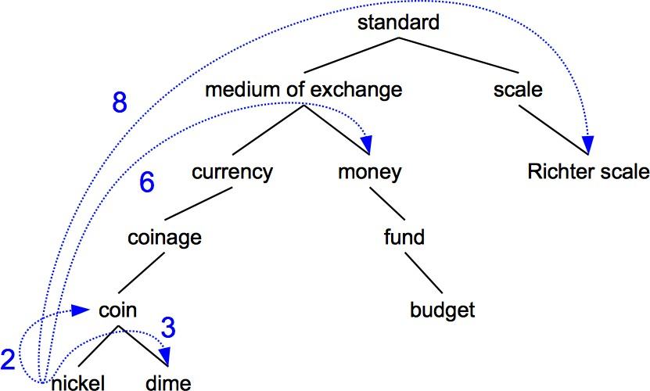
Path-based similarity
Two concepts (senses/synsets) are similar if they are near each other in the thesaurus hierarchy
• =have a short path between them
concepts have path 1 to themselves

Slide 20
Reﬁnements to path-­‐based similarity
pathlen(c₁,c₂) = (distance metric) = 1 + number of edges in the shortest path in the hypernym graph between sense nodes c₁ and c₂
1
Sense similarity metric: 1 over the distance!
simpath(c₁,c₂) =
pathlen(c , c )
1 2
wordsim(w₁,w₂) = max sim(c₁,c₂)
c₁∈senses(w₁),c₂∈senses(w₂)
Word similarity metric: max similarity among pairs of senses.
For all senses of w1 and all senses of w2, take the similarity between each of the senses of w1 and each of the senses of w2 and then take the maximum similarity between those pairs.

Slide 21
Example: path-­‐based similarity
simpath(c₁,c₂) = 1/pathlen(c₁,c₂)
simpath(nickel,coin) = 1/2 = .5 simpath(fund,budget) = 1/2 = .5 simpath(nickel,currency) = 1/4 = .25 simpath(nickel,money) = 1/6 = .17 simpath(coinage,Richter scale) = 1/6 = .17

Slide 22
Problem with basic path-­‐based similarity
Assumes each link represents a uniform distance
But nickel to money seems to us to be closer than nickel to
standard
Nodes high in the hierarchy are very abstract
We instead want a metric that
Represents the cost of each edge independently
Words connected only through abstract nodes
are less similar

Slide 23
Information content similarity metrics
Resnik 1995. Using information content to evaluate semantic
In simple words:
similarity in a taxonomy. IJCAI
We define the probability of a concept C as the probability that a randomly selected word in a corpus is an instance of that concept.
Basically, for each random word in a corpus we compute how probable it is that it belongs to a certain concepts.

Slide 24
Formally: Information content similarity metrics
Resnik 1995. Using information content to evaluate semantic
Let’s define P(c) as:
similarity in a taxonomy. IJCAI
The probability that a randomly selected word in a corpus is an instance of concept c
Formally: there is a distinct random variable, ranging over words, associated with each concept in the hierarchy
for a given concept, each observed noun is either
a member of that concept with probability P(c)
not a member of that concept with probability 1-P(c)
All words are members of the root node (Entity)
P(root)=1
The lower a node in hierarchy, the lower its probability

Slide 25
Information content similarity
entity
…
geological-­‐formation
natural elevation cave shore hill ridge grotto coast
For every word (ex “natural elevation”), we count all the words in that concepts, and then we normalize by the total number of words in the corpus.
we get a probability value that tells us how probable it is that a random word is a an instance of that concept
In order o compute the probability of the term "natural elevation", we take ridge, hill + natural elevation itself
∑
count(w)
_{P(c) =} w∈words(c)
N

Slide 26
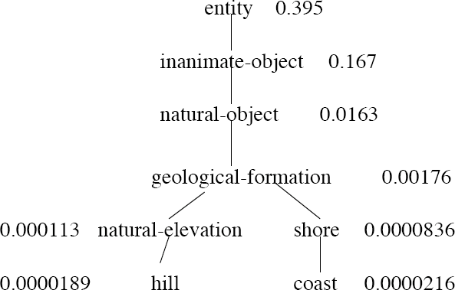
Information content similarity
WordNet hierarchy augmented with probabilities P(c)
D. Lin. 1998. An Information-­‐Theoretic Definition of Similarity. ICML 1998

Slide 27
Information content: deﬁnitions
Information content:
IC(c) = -log P(c)
Most informative subsumer
(Lowest common subsumer)
LCS(c₁,c₂) =
The most informative (lowest) node in the hierarchy subsuming both c₁ and c₂

Slide 28
A lot of people prefer the term surprisal to information or to information content.
-­‐log p(x)
It measures the amount of surprise generated by the event x.
The smaller the probability of x, the bigger the surprisal is.
It's helpful to think about it this way, particularly for linguistics examples.

Slide 29
Using information content for similarity: the Resnik method
Philip Resnik. 1995. Using Information Content to Evaluate Semantic Similarity in a Taxonomy. IJCAI 1995. Philip Resnik. 1999. Semantic Similarity in a Taxonomy: An Information-­‐Based Measure and its Application to Problems of Ambiguity in Natural Language. JAIR 11, 95-­‐130.
The similarity between two words is related to their common information
The more two words have in common, the more similar they are
Resnik: measure common information as:
The information content of the most informative (lowest) subsumer (MIS/LCS) of the two nodes
sim_{resnik}(c₁,c₂) = -log P( LCS(c₁,c₂) )

Slide 30
Dekang Lin method
Dekang Lin. 1998. An Information-­‐Theoretic Definition of Similarity. ICML
Intuition: Similarity between A and B is not just what they have in common
The more diﬀerences between A and B, the less similar they are:
Commonality: the more A and B have in common, the more similar they are
Diﬀerence: the more diﬀerences between A and B, the less similar
Commonality: IC(common(A,B))
Diﬀerence: IC(description(A,B)-­‐IC(common(A,B))

Slide 31
Dekang Lin similarity theorem
The similarity between A and B is measured by the ratio between the amount of information needed to state the commonality of A and B and the information needed to fully describe what A and B are
IC(common(A, B))
sim (A, B) ∝
Lin
IC(description(A, B))
Lin (altering Resnik) defines IC(common(A,B)) as 2 x information of the LCS
2 log P(LCS(c , c ))
sim (c , c ) =
1 2
Lin 1 2
log P(c₁) + log P(c₂ )

Slide 32
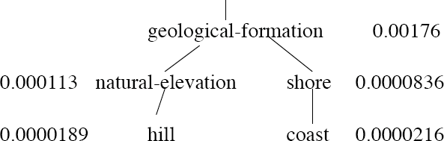
Lin similarity function
_{(A, B) =} 2 log P(LCS(c₁, c₂ ))
sim
Lin
log P(c₁) + log P(c₂ )
_{(hill, coast) =} 2 log P(geological-formation)
sim
Lin
log P(hill) + log P(coast)
2 ln 0.00176
=
ln 0.0000189 + ln 0.0000216
=.59

Slide 33
The (extended) Lesk Algorithm
A thesaurus-­‐based measure that looks at glosses
Two concepts are similar if their glosses contain similar words
Drawing paper: paper that is specially prepared for use in drafting
Decal: the art of transferring designs from specially prepared paper to a wood or glass or metal surface
For each n-­‐word phrase that’s in both glosses
Add a score of n²
Paper and specially prepared for 1 + 2² = 5
Compute overlap also for other relations
glosses of hypernyms and hyponyms

Slide 34
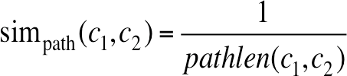
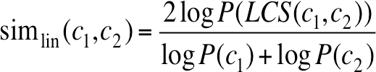

Summary: thesaurus-­‐based similarity

Slide 35
Libraries for computing thesaurus-­‐based similarity
NLTK
http://nltk.github.com/api/nltk.corpus.reader.html?highlight=similarity -­‐ nltk.corpus.reader.WordNetCorpusReader.res_similarity
WordNet::Similarity
http://wn-­‐similarity.sourceforge.net/
Web-­‐based interface:
http://marimba.d.umn.edu/cgi-­‐bin/similarity/similarity.cgi
44

Slide 36
Machine Learning based approach

Slide 37
Basic idea
If we have data that has been hand-­‐labelled with correct word senses, we can used a supervised learning approach and learn from it!
We need to extract features and train a classifier
The output of training is an automatic system capable of assigning sense labels TO unlabelled words in a context.
46

Slide 38
Two variants of WSD task
Lexical Sample task
(we need labelled corpora for individual senses)
SENSEVAL 1-­‐2-­‐3
Small pre-­‐selected set of target words (ex diﬃculty)
And inventory of senses for each word
Supervised machine learning: train a classiﬁer for each word
All-­‐words task
(each word in each sentence is labelled with a sense)
Every word in an entire text
A lexicon with senses for each word

Slide 39
Supervised Machine Learning Approaches
Summary of what we need:
the tag set (“sense inventory”)
the training corpus
A set of features extracted from the training corpus
A classiﬁer

Slide 40
Supervised WSD 1: WSD Tags
What’s a tag?
A dictionary sense?
For example, for WordNet an instance of “bass” in a text has 8 possible tags or labels (bass1 through bass8).

Slide 41
8 senses of “bass” in WordNet
bass -­‐ (the lowest part of the musical range)
bass, bass part -­‐ (the lowest part in polyphonic music)
bass, basso -­‐ (an adult male singer with the lowest voice)
sea bass, bass -­‐ (ﬂesh of lean-­‐ﬂeshed saltwater fish of the family Serranidae)
freshwater bass, bass -­‐ (any of various North American lean-­‐ﬂeshed freshwater fishes especially of the genus Micropterus)
bass, bass voice, basso -­‐ (the lowest adult male singing voice)
bass -­‐ (the member with the lowest range of a family of musical instruments)
bass -­‐ (nontechnical name for any of numerous edible marine and freshwater spiny-­‐finned fishes)

Slide 42
SemCor
SemCor: 234,000 words from Brown Corpus, manually tagged with WordNet senses
<wf pos=PRP>He</wf>
<wf pos=VB lemma=recognize wnsn=4 lexsn=2:31:00::>recognized</wf>
<wf pos=DT>the</wf>
<wf pos=NN lemma=gesture wnsn=1 lexsn=1:04:00::>gesture</wf>
<punc>.</punc>
51

Slide 43
Supervised WSD: Extract feature vectors Intuition from Warren Weaver (1955):
“If one examines the words in a book, one at a time as through an opaque mask with a hole in it one word wide, then it is obviously impossible to determine, one at a time, the meaning of the words…
But if one lengthens the slit in the opaque mask, until one can see not only the central word in question but also say N words on either side, then if N is large enough one can unambiguously
decide the meaning of the central word…
the window
The practical question is : ``What minimum value of N will, at least in a tolerable fraction of cases, lead to the correct choice of meaning for the central word?”

Slide 44
Feature vectors
Vectors of sets of feature/value pairs

Slide 45
Two kinds of features in the vectors
Generally speaking, a collocation is a sequence of words or terms that co-occur more often than would be expected by chance. But here the meaning is not exactly this…
Collocational features and bag-­‐of-­‐words features
Collocational/Paradigmatic
Features about words at speciﬁc positions near target word
Often limited to just word identity and POS
Bag-­‐of-­‐words
Features about words that occur anywhere in the window (regardless of position)
Typically limited to frequency counts

Slide 46
Examples
Example text (WSJ):
An electric guitar and bass player stand oﬀ to one side not really part of the scene
Assume a window of +/-­‐ 2 from the target

Slide 47
Examples
Example text (WSJ)
one side not really part of the scene,
Assume a window of +/-­‐ 2 from the target
An electric bass
oﬀ to
guitar
and
player
stand

Slide 48
Collocational features
Position-­‐specific information about the words and collocations in window
•
guitar
and
bass
player
stand
, POS , w , POS_{i—1}, w , POS , w , POS , w
i—1 i+1
[wi—2
, w ]
i—2 i—1 i+1 i+1 i+2 i+2
i—2 i
[guitar, NN, and, CC, player, NN, stand, VB, and guitar, player stand]
word 1,2,3 grams in window of ±3 is common

Slide 49
Bag-­‐of-­‐words features
“an unordered set of words” – position ignored
Choose a vocabulary: a useful subset of words in a training corpus
Either: the count of how often each of those terms occurs in a given window OR just a binary “indicator” 1 or 0

Slide 50
Co-­‐Occurrence Example
Assume we’ve settled on a possible vocabulary of 12 words in “bass” sentences:
[ﬁshing, big, sound, player, ﬂy, rod, pound, double, runs, playing, guitar, band]
The vector for:
guitar and bass player stand
[0,0,0,1,0,0,0,0,0,0,1,0]

Slide 51
Word Sense Disambiguation
Classification

Slide 52
Classiﬁcation
Input:
a word w and some features f
a fixed set of classes C = {c₁, c₂,…, c_{J}}
Any kind of classifier
Naive Bayes
Logistic regression
Neural Networks
Support-­‐vector machines
k-­‐Nearest Neighbors
etc.
Output: a predicted class c∈C

Slide 53
Coherence
Coherence in discourse refers to the way in which the sentences of a text relate to each other to form a unified whole. An important aspect of coherence is how references (like pronouns, noun phrases, etc.) are used to maintain the flow and connectivity of ideas. Coherence reference phenomena are mechanisms that help achieve this connection.
Coherence Reference Phenomena
Anaphora: Anaphora is a reference to something previously mentioned in the discourse.
Example: "John went to the store. He bought some milk." ("He" refers to "John")
Cataphora: Cataphora is a reference to something that is mentioned later in the discourse.
Example: "Before he could leave, John had to finish his work." ("he" refers to "John")
Exophora: Exophora is a reference to something outside the text, often in the physical or situational context.
Example: "Look at that!" (where "that" refers to something in the physical environment)
Endophora: Endophora is a general term for both anaphora and cataphora, i.e., references within the text.
Anaphoric endophora: "He was hungry. John ate an apple."
Cataphoric endophora: "When he arrived, John was tired."
Coreference: Coreference occurs when two or more expressions in a text refer to the same entity.
Example: "Alice lost her book. She can't find it anywhere." ("her" and "she" refer to "Alice", and "it" refers to "her book")

Slide 54
Penn Tree Bank
Penn Treebank is a large annotated corpus of English that is widely used in computational linguistics and natural language processing (NLP) for training and evaluating algorithms. It was created by the University of Pennsylvania's Linguistic Data Consortium and has been a foundational resource in the field.
Key Features of the Penn Treebank
Annotated Corpus: The Penn Treebank includes syntactic and semantic annotations of texts, making it a valuable resource for developing and testing NLP models.
Part-of-Speech (POS) Tagging: It provides POS tags for each word, which are essential for various NLP tasks such as lemmatization, parsing, and machine translation.
Syntactic Trees: The corpus contains syntactic trees that represent the grammatical structure of sentences. These trees are crucial for tasks such as syntactic parsing and grammar induction.
Wide Coverage: It includes texts from various genres, such as Wall Street Journal articles, telephone conversations, and more, offering a broad spectrum of English language use.

Slide 55
Penn Treebank POS Tags
The Penn Treebank uses a set of POS tags to annotate words. Here is a list of some common tags:
CC: Coordinating conjunction
CD: Cardinal number
DT: Determiner
EX: Existential there
FW: Foreign word
IN: Preposition or subordinating conjunction
JJ: Adjective
JJR: Adjective, comparative
JJS: Adjective, superlative
LS: List item marker

Slide 56
MD: Modal
NN: Noun, singular or mass
NNS: Noun, plural
NNP: Proper noun, singular
NNPS: Proper noun, plural
PDT: Predeterminer
POS: Possessive ending
PRP: Personal pronoun
PRP$: Possessive pronoun
RB: Adverb
RBR: Adverb, comparative
RBS: Adverb, superlative

Slide 57
RP: Particle
SYM: Symbol
TO: to
UH: Interjection
VB: Verb, base form
VBD: Verb, past tense
VBG: Verb, gerund or present participle
VBN: Verb, past participle
VBP: Verb, non-3rd person singular present
VBZ: Verb, 3rd person singular present
WDT: Wh-determiner
WP: Wh-pronoun
WP$: Possessive wh-pronoun
WRB: Wh-adverb

Slide 58
Example Sentence with Penn Treebank POS Tags
Consider the sentence: "The quick brown fox jumps over the lazy dog."
Here is how it might be tagged using Penn Treebank POS tags:
The/DT quick/JJ brown/JJ fox/NN jumps/VBZ over/IN the/DT lazy/JJ dog/NN

Slide 59
Applications of the Penn Treebank
POS Tagging: The POS-tagged data is used to train and evaluate POS taggers.
Syntactic Parsing: The syntactic trees are used to train parsers that can predict the syntactic structure of sentences.
Machine Learning: The annotated data serves as a benchmark for various machine learning models in NLP.
Linguistic Research: Researchers use the Penn Treebank to study syntactic and semantic phenomena in English.

